Slide 1

Parametric survival models
Steve Simon for
Notes:
Analyzing Repeated Measures Data Workshop: Module 5 The Linear Mixed Model
Copyright 2011 The Analysis Factor http://TheAnalysisFactor.com
1

Slide 2
Abstract
Lecture 6.
Parametric models. Parametric models provide an alternative analysis to the Cox proportional hazards model. You’ll compare the hazard function for various popular survival distributions and understand the advantages and disadvantages of a parametric approach to survival. You’ll fit parametric models and interpret the coefficients.

Slide 3
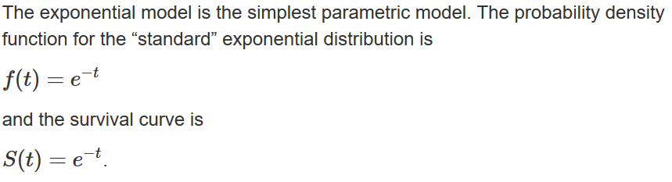
The exponential distribution
The “standard” exponential distribution.

Slide 4
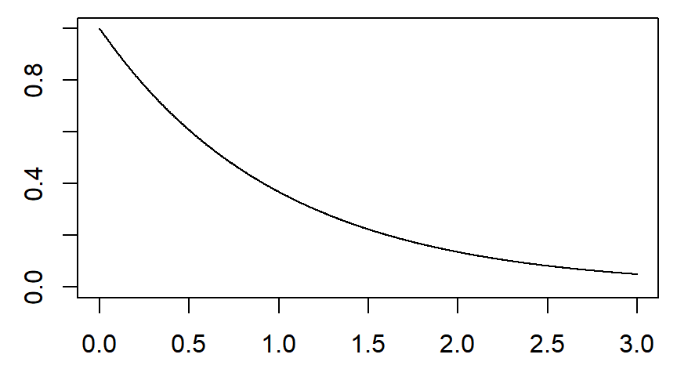
Survival curve for the “standard” exponential

Slide 5
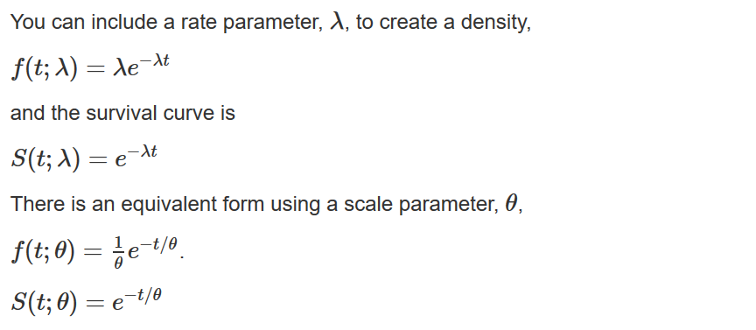
The exponential distribution
The rate and scale parameters.

Slide 6
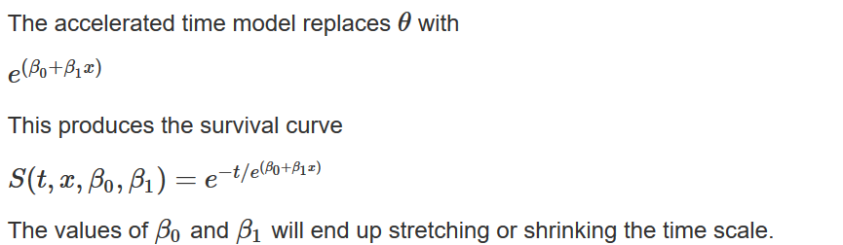
The exponential distribution
The accelerated time model.

Slide 7
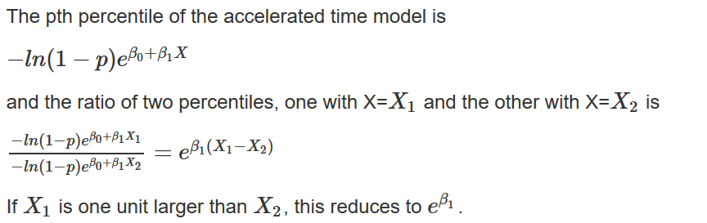
The exponential distribution
Comparison of percentiles.

Slide 8
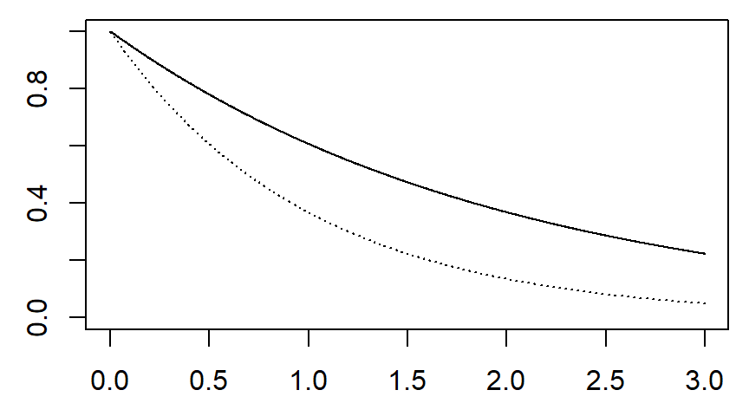
Survival curve for θ=2

Slide 9
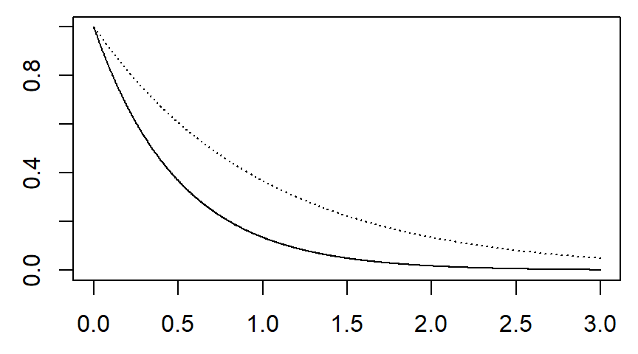
Survival curve for θ=0.5

Slide 10
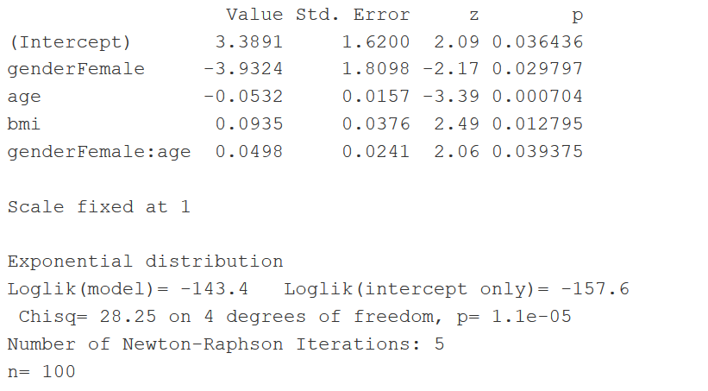
The exponential distribution

Slide 11
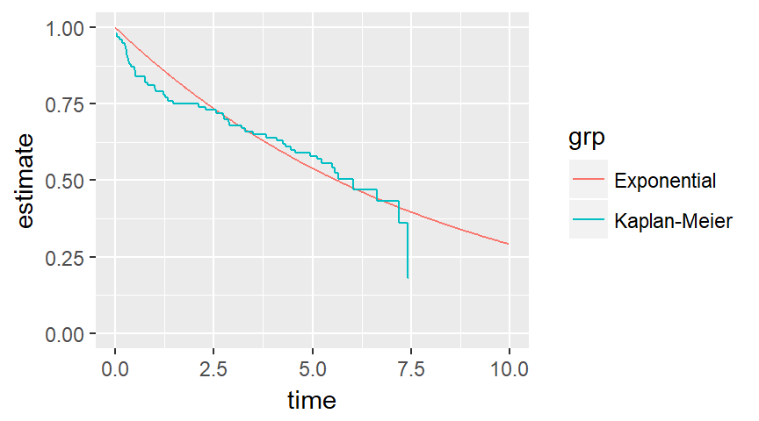
Survival curves (no covariates)

Slide 12
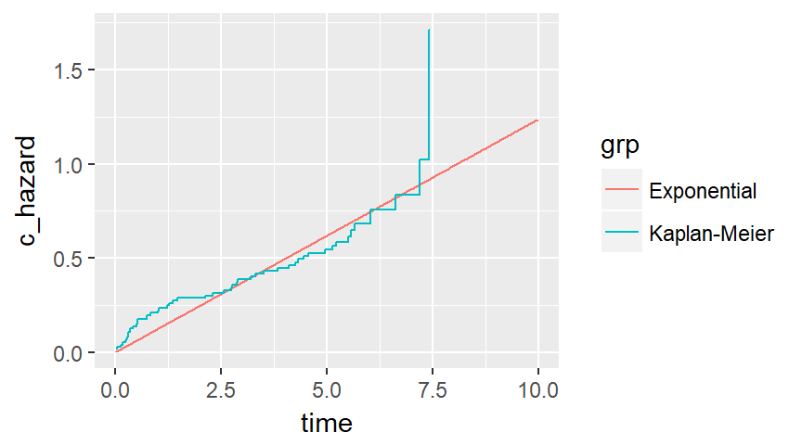
Cumulative hazards (no covariates)

Slide 13
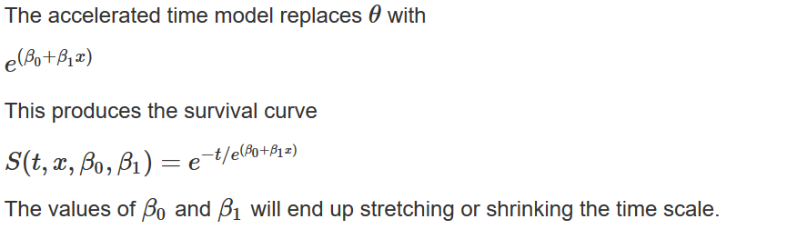
The exponential distribution
The accelerated time model.

Slide 14
Conclusion
What have you learned today?
The

